Slide 1

Adobe Flex
[Image coming]
Kevin Hoyt
Senior Product Specialist

Slide 2
Flex 2 Key Points
Expressiveness
  Vectors, Drawing API
  Rich media
Performance
  Compiled code
  JIT
Real-time
  Binary sockets
  Collaboration, push
Productivity

Slide 3

Flex 2 Product Line
Flex SDK 2
Flex Builder 2
MXML and ActionScript 3.0
Visual Layout
Flex Framework and Class Library
Code Hinting
Command-line Compiler & Debugger
Debugging
Flex
Charting 2
Skinning and Styling
Extensible Charting Components
Flex Data Services 2
Message Service
Data Management Service
RPC Services

Slide 4
Flex Data Services 2
Flex Data Services
RPC Services
Data Management
Messaging
Web Service
Data Synch.
Collaboration
HTTP Service
OCC
Publish/Subscribe
Runtime Compiler
Remote Object
Paging
Data Push
Service Adapters
Java
JMS
Hibernate
ColdFusion
Custom…

Slide 5
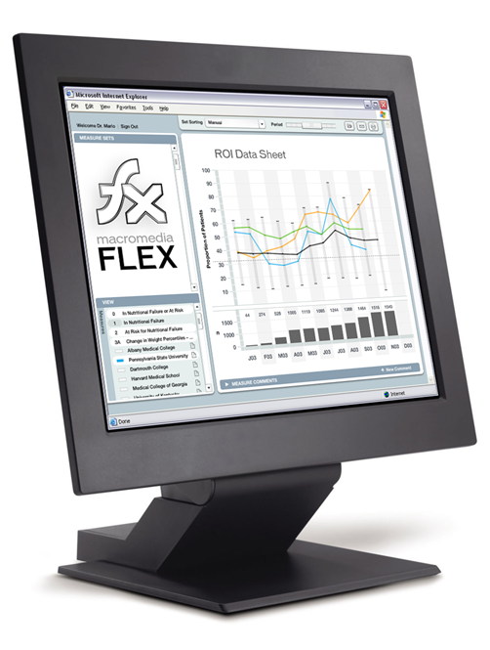
Client-Initiated Messaging
Flex Data Services
Messaging
System X
Adapter X
Message
Service
JMS
Provider
Endpoint
JMS Adapter
Messaging
System Y
Adapter Y
RTMP
AMF
HTTP
Publisher
Subscriber
Notes:
The examples so far were simple and covered Flex client to Flex client messaging. In this case, the Flex Message Service is all you need.
In real life situations, you often have to exchange messages between disparate systems. The goal of the Flex Messaging Service is not to reinvent the wheel and replace existing messaging systems. On the opposite, the goal is to integrate with existing systems, and extend them to allow Flex clients to publish and subscribe to topics these existing systems manage. This is a major advantage/differentiator over traditional HTML/Ajax-based applications where messages cannot be pushed in a scalable and reliable way.
The Flex Message Service integrates with existing messaging systems through a set of adapters. we provide a JMS adapter, and there is a simple and documented API to allow vendors and developers to develop their own adapters for non-JMS messaging systems.

Slide 6
Real-Time Data Push
Flex Data Services
Messaging
System X
Adapter X
Message
Services
JMS
Provider
Endpoint
JMS Adapter
Messaging
System Y
Adapter Y
RTMP
AMF
HTTP
Publisher
Subscriber
Notes:
In the previous examples, messages were initiated by the client. There are many situations where you want the messages to be initiated by a server process. These are traditional data push use cases.

Slide 7
Data Management
Flex Data Services
RDBMS
JDBC
Adapter
Client A
Endpoint
Data
Service
DAO
Object
Adapter
Client B
Hibernate
Hibernate
Adapter
CFC
Adapter
ColdFusion
Client C
Notes:
Because the Data Service is built on top of the Message Service, other clients who subscribe to the same destination can be notified automatically when the data changes. This can be extremely useful for applications that require end users to always deal with extremely fresh data.

Slide 8
Adobe Flex
[Image coming]
Kevin Hoyt
Senior Product Specialist

